Slide 1
Digital Logic Fundamentals
Dr. Hammad Afzal
Military College of Signals
National University of Sciences and Technology, Pakistan
Spring, 2011
hammad.afzal@mcs.edu.pk

Slide 2
Chapter 1 – Digital Systems and Binary Numbers

Slide 3
Binary Codes

Slide 4
The 8421 BCD
BCD stands for Binary-Coded Decimal.
A BCD number is a four-bit binary group that represents one of the ten decimal digits 0 through 9
Decimal Digit | 0 | 1 | 2 | 3 | 4 | 5 | 6 | 7 | 8 | 9
BCD | 0000 | 0001 | 0010 | 0011 | 0100 | 0101 | 0110 | 0111 | 1000 | 1001
Note: 1010, 1011, 1100, 1101, 1110, and 1111 are INVALID CODE!

Slide 5
BCD
Example:
Decimal number 4926 4 9 2 6
8421 BCD coded number 0100 1001 0010 0110

Slide 6
Question
Convert the BCD coded number
1000 0111 0001 into decimal.
BCD Coded Number 1000 0111 0001
Decimal Number 8 7 1

Slide 7
BCD
People understand decimal system better
BCD makes it easy to replace a decimal number with an individual binary code
Decimal 15 is BCD 0001 0101 in Binary it was 1111
Since most computers store data in eight-bit bytes
Ignore 4 extra bits
One can store two digits per byte, called "packed" BCD

Slide 8
BCD Addition
BCD is a numerical code and can be used in arithmetic operations. Here is how to add two BCD numbers:
Add the two BCD numbers, using the rules for basic binary addition.
If a 4-bit sum is equal to or less than 9, it is a valid BCD number.
If a 4-bit sum > 9, or if a carry out of the 4-bit group is generated it is an invalid result. Add 6 (0110) to a 4-bit sum in order to skip the six the invalid states and return the code to 8421. If a carry results when 6 is added, simply add the carry to the next 4-bit group.

Slide 9
BCD Addition - Examples
4+5
 | 0 | 1 | 0 | 0
+ | 0 | 1 | 0 | 1
 | 1 | 0 | 0 | 1
4+8
 | 0 | 1 | 0 | 0
+ | 1 | 0 | 0 | 0
 | 1 | 1 | 0 | 0
Sum is greater than 1001
+ | 0 | 1 | 1 | 0
1 | 0 | 0 | 1 | 0
Add 0110

Slide 10
BCD Addition - Examples
184+576
 |  |  |  | 1 |  |  |  |  | 1
 | 0 | 0 | 0 | 1 |  | 1 | 0 | 0 | 0 |  | 0 | 1 | 0 | 0
+ | 0 | 1 | 0 | 1 |  | 0 | 1 | 1 | 1 |  | 0 | 1 | 1 | 0
 | 0 | 1 | 1 | 1 | 1 | 0 | 0 | 0 | 0 |  | 1 | 0 | 1 | 0
 |  |  |  |  |  | 0 | 1 | 1 | 0 | + | 0 | 1 | 1 | 0
 | 0 | 1 | 1 | 1 |  | 0 | 1 | 1 | 0 |  | 0 | 0 | 0 | 0
184
576
760

Slide 11
The Excess-3 Code
Add 3 to each digit of decimal and convert to 4-bit binary form
Decimal Binary +3 Excess-3
0 0000 0011 0011
1 0001 0011 0100
2 0010 0011 0101
3 0011 0011 0110
4 0100 0011 0111
5 0101 0011 1000
6 0110 0011 1001
7 0111 0011 1010
8 1000 0011 1011
9 1001 0011 1100
Sample Problem:
Decimal 3 5 9
Excess-3 0110 1000 1100

Slide 12
Self Complementing Codes
The codes representing the pair of complementary digits are also complementary to each other.
Example: Excess-3 code
0: 0011
1: 0100
2: 0101
3: 0110
4: 0111
5: 1000
6: 1001
7: 1010
8: 1011
9: 1100

Slide 13
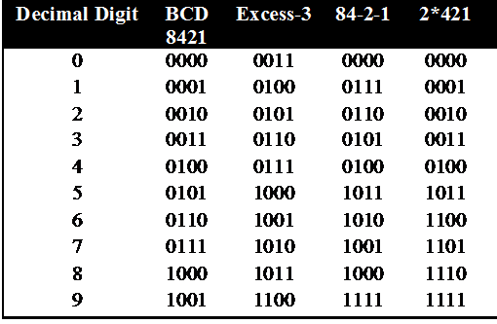
Some Weighted Codes
Weight codes – Different position has different weight
8421 code 0101=0x8+1x4+0x2+1x1=5
84-2-1 0101=0x8+1x4+0x(-2)+1x(-1)=3

Slide 14
The Gray Code
Unweighted Code
Only a single bit change from one code value to the next.
Example: 4-bit standard Gray code

Slide 15
Table 1.9 Nonweighted Codes
Decimal Excess-3 code Gray code
0 0011 0000
1 0100 0001
2 0101 0011
3 0110 0010
4 0111 0110
5 1000 0111
6 1001 0101
7 1010 0100
8 1011 1100
9 1100 1101
10 1111
11 Not 1110
12 defined 1010
13 1011
14 1001
15 1000

Slide 16

Warning: Conversion or Coding
Do NOT mix up conversion of a decimal number to a binary number with coding a decimal number with a BINARY CODE.
13₁₀ = 1101₂ (This is conversion)
13 ⇔ 0001|0011 (This is coding)

Slide 17
Character Codes - ASCII
Many applications require handling of not only numbers but letters and special characters
ASCII – American Standard Code for Information Interchange
7 Bits to store 128 characters
In ASCII, every letter, number, and punctuation symbol has a corresponding number, or ASCII code

Slide 18
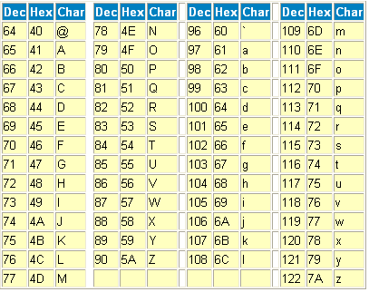
ASCII Table

Slide 19
Error Detection
Errors can occur during data transmission. They should be detected, so that re-transmission can be requested.
With binary numbers, usually single-bit errors occur.
Example: 0010 erroneously transmitted as 0011 or 0000 or 0110 or 1010.

Slide 20
Even Parity
Even parity – set bit to make number of 1’s even
Examples
1000001 with even parity is 01000001
1000011 with even parity is 11000011

Slide 21
Odd Parity
Similar except make the number of 1’s odd
Examples
1000001 with odd parity is 11000001
1000011 with odd parity is 01000011

Slide 22
Error Detection
Parity bit can detect odd number of errors but not even number of errors.
Example: Assume odd parity,
10011 → 10001 (detected)
10011 → 10101 (not detected)

Slide 23
Error Detection
Parity bit
Even parity: additional bit added to make total number of 1’s even.
Odd parity: additional bit added to make total number of 1’s odd.
Example of odd parity on ASCII values.
Parity bits

Slide 24

Reading Assignment
Binary Storage and Registers

Slide 25
Binary Logic
Binary logic consists of binary variables and a set of logical operations.
The binary variables can have only two values:0 and 1.
The basic logical operations are AND, OR, and NOT.
For x and y binary variables the three logical operations are shown as:
AND operation . x.y
OR operation + x+y
NOT operation ' x'

Slide 26
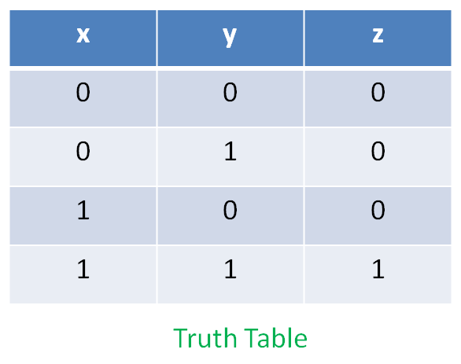
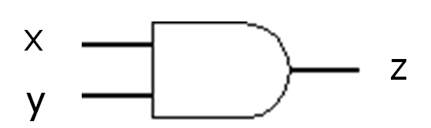
The AND Operation
The circuit represents AND operation and is called AND gate
Two or more input bits produce one output bit.
Both inputs must be true (1) for the output to be true.
Otherwise the output is false (0).

Slide 27
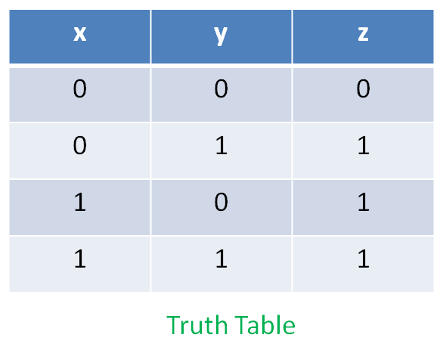
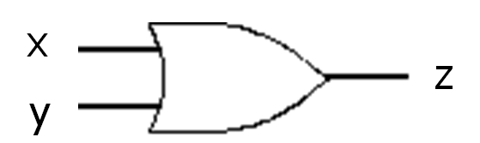
The OR Operation
The circuit represents OR operation and is called OR gate
Two or more input bits produce one output bit.
Either inputs must be true (1) for the output to be true.

Slide 28
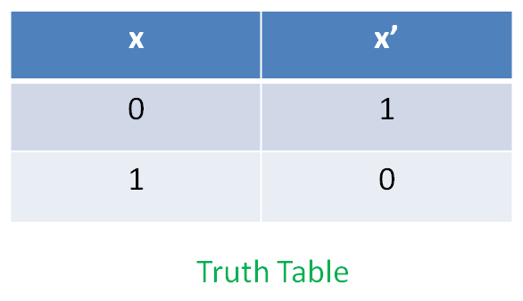
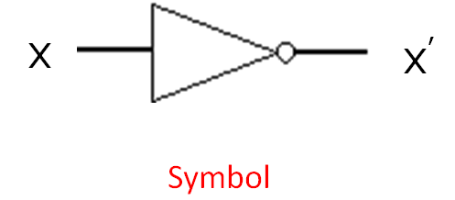
The NOT Operation - Inverter
The circuit represents NOT operation and is called NOT gate or INVERTER
One bit as input produces its opposite as output.

Slide 29
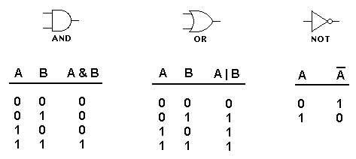
Truth Tables of Logic Operations

Slide 30
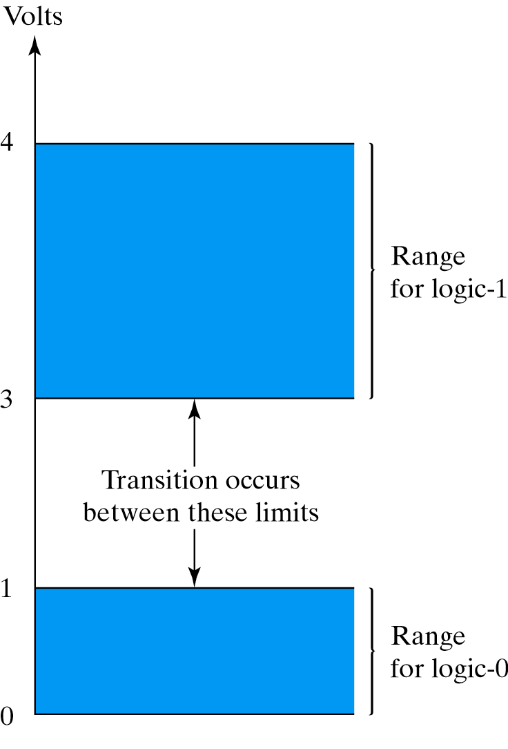
Representation of Binary variables
Different Digital Systems represent 0 and 1 differently
Logical 0 as 0 volts. Logical 1 as 4 volts
Range

Slide 31
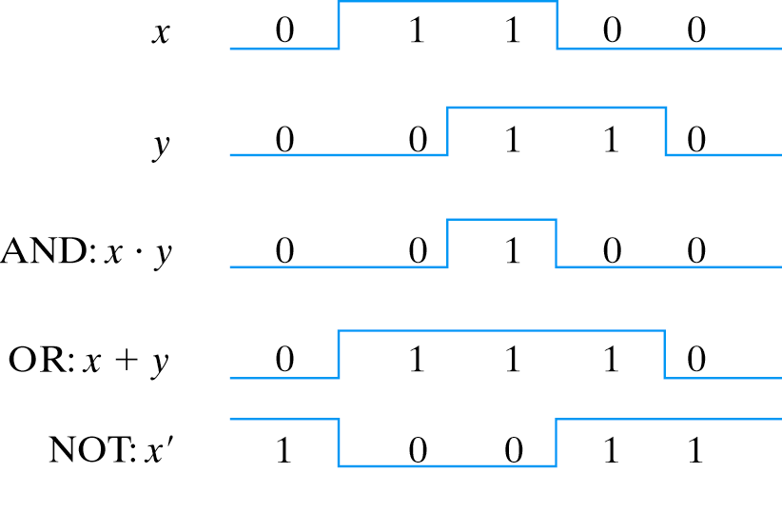
Binary Logic Functions

Slide 32
References
Chapter 1 – Digital Design Morris Mano
Digital Logic and Computer Design – M. Singh, University of North Carolina
Digital Design – O. Ozturk, Bilknet University
Material in these slides has been taken from, the following resources

